Slide 1
Data Programming in R Group Project
Group <- c ( Kris Arens , Ben Huntington , Michelle Cutlip , Cody Burger , Matthew Pelham )
Notes:
Michelle - introductions

Slide 2
The situation
Situation <- What factors contribute to a post-secondary school’s student loan default rate?
Influence of cost of attendance on default rate
Correlations between school type and default rate
What geographic areas have the highest and lowest default rates
Notes:
Michelle
Situation: Default = no payment in last 270 days
Analyze data from post-secondary institutions which means programs eligible for Federal Funding. This included schools such as vocational/technical training up through a public or private college institutions. Non-degree (0-3 years), associates, masters, PhD.
300—FY 2013, FY 2012, and FY 2011 official cohort default rates published for schools participating in the Title IV student financial assistance programs.
A school’s cohort default rate is the percentage of a school’s federal student loan borrowers who enter repayment within the cohort fiscal year (denominator) and default (or met other specified condition) (numerator) within the cohort default period.
Why are cohort default rates important? Defaulted federal student loans cost taxpayers money. Cohort default rate sanctions and benefits provide an incentive to schools to work with their borrowers to reduce default. Sanctions also can prevent a school with a high percentage of defaulters from continuing to participate in the William D. Ford Federal Direct Loan (Direct Loan) and Federal Pell Grant (Pell Grant) programs. As a result, cohort default rates help save taxpayers money
3 areas of focus to answer this question are: geographic areas, school type, and cost of attendance.
School type: The code identifying the ownership control of the institution:
1—Public 2—Private, Nonprofit
3—Proprietary 5—Foreign public
6—Foreign private 7—Foreign For-Profit

Slide 3
Data sources
> Department of Education Federal Student Aid (Peps300)
School default rate
School type
Program length
School ethnic affiliation
Number of students in default
Number of students in repayment
> National Center for Education Statistics (IPEDS)
School longitude and latitude coordinates
School attendance numbers
School tuition and fees
OPEID and Unit ID
Notes:
Michelle
Initial dataset was from US Department of Education Federal Student Aid (School cohort default rate data file)
Data was organized by school, each with an OPEID (Office of Postsecondary Education Identifier)
Program length: The length of the longest program offered by the institution. Includes from non-degree programs up through institutions offering PhD degrees
0—Short-Term (300–599 hours) 1—Graduate/Professional (≥ 300 hours) 2—Non-Degree (600–899 hours)
3—Non-Degree 1 Year (900–1799 hours) 4—Non-Degree 2 Years (1800–2699 hours) 5—Associate's Degree
6—Bachelor's Degree 7—First Professional Degree 8—Master's Degree or Doctor's Degree
9—Professional Certification 10—Undergraduate (Previous Degree Required) 11—Non-Degree 3 Plus Years (≥ 2700 hours)
12—Two-Year Transfer
Ethnic Code The code classifying the ethnic affiliation of the institution:
1—Native American 2—HBCU (historically black college/university) 3—Hispanic 4—Traditionally Black College 5—Ethnicity Not Reported
To strengthen data, located other data about schools on National Center for Education Statistics – Integrated Postsecondary Education Data System
The Integrated Postsecondary Education Data System (IPEDS) is a system of interrelated surveys conducted annually by the U.S. Department of Education's National Center for Education Statistics (NCES). IPEDS annually gathers information from more than 7,500 colleges, universities, and technical and vocational institutions that participate in the federal student aid programs.
Various datasets organized by school
Chose 3 datasets – each with many variables but interested in only (IC – 145 (cost), HC- 66 (long/lat), EFFY – 34 (attendance)
Attendance
Latitude and longitude
Cost
Downloaded datasets (3 years x 3 datasets)
Combined into one Excel spreadsheet pulling in only columns of interest
Each subset and year was put on it’s own sheet in IPEDS full dataset

Slide 4
initial Project challenges
> Locating school data
> Finding table to sync OPEID and UNITID
> Streamlining correspondence and splitting the work breakdown
Notes:
Michelle
Locating school data
2 group members work in postsecondary education, 3 work for insurance companies
Decided to research postsecondary education data from the group members schools, but that wasn’t possible.
Internet searches to find data of interest.
OPEID and UNITID
Department of Education Federal Student Aid data indexed by UNITID
IPEDS data – most indexed by OPEID
Search to find a data table with both values to use to join the data – found on IPEDS site
The numbers needed manipulation by removing leading 0’s in one table, adding 0’s in another in order to match
Correspondence
How to communicate – started with a “group” in ICON, but found that follow-up discussions weren’t alerting members to new message.
Also, no way to track file versions.
Switched to group email and to GitHub for file sharing
Challenge in deciding how to split up the work. Split up into: 3 people each take a sub-topic to study, code, graph
One person concentrate on importing and meshing the data, and writing the function.
One person worked on IPEDS dataset, renamed columns, organized paper and powerpoint..

Slide 5
Importing and combining the data
Function
Joining the dataframes
Notes:
Matt
Discuss function to pull in data and join the dataframes
Each of the 3 types of analyses code were created, and wrapped into separate functions
Challenges in setting this up

Slide 6
Cleaning the data
Notes:
Matt

Slide 7
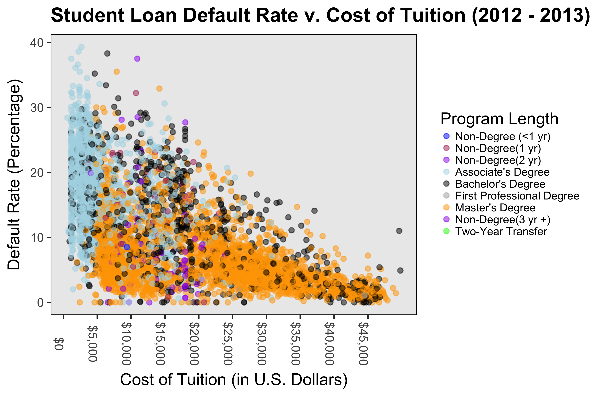
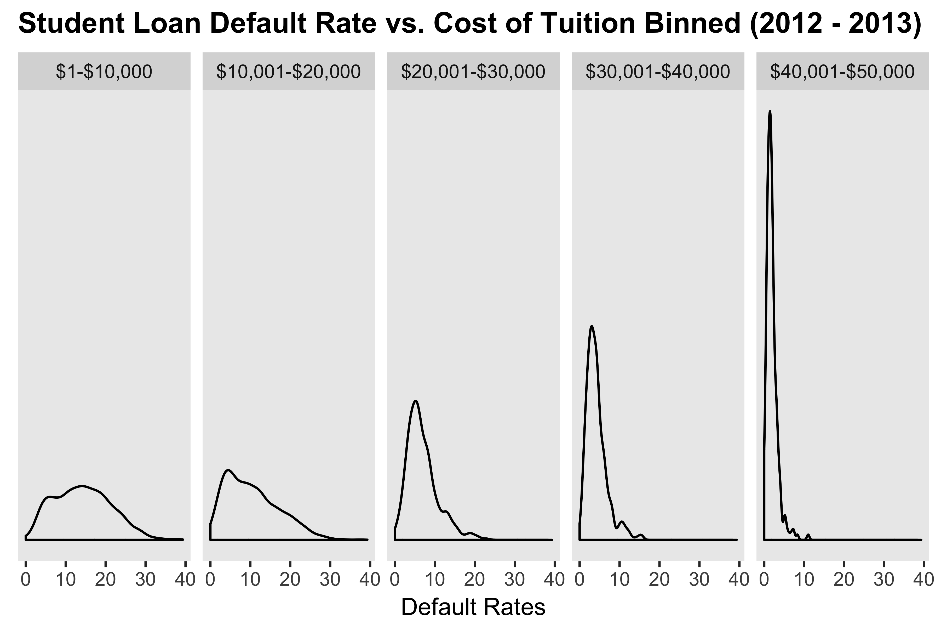
Default Rate on Cost of tuition measured by: program length
Notes:
Cody

Slide 8
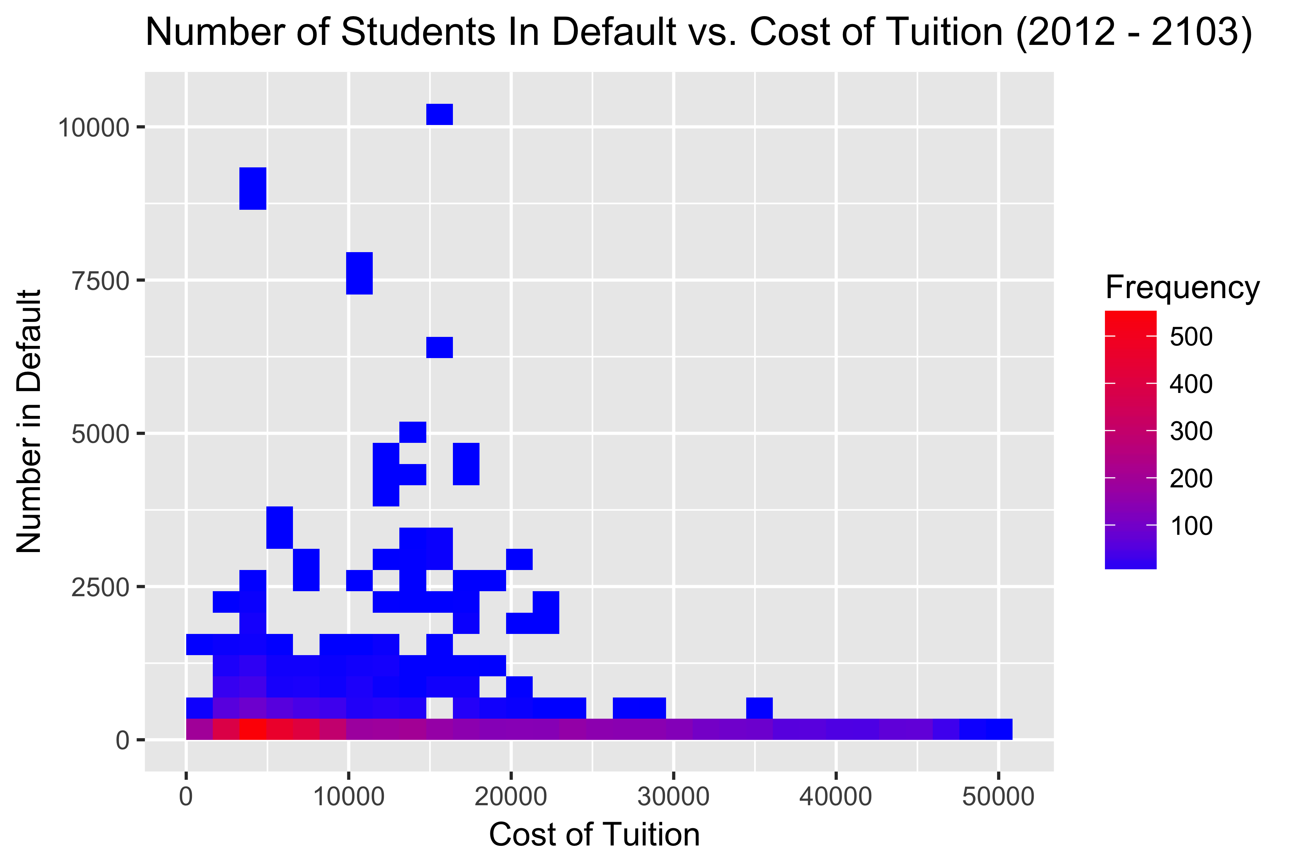
Density plot outlining number of students in default on cost of tuition
Notes:
Cody

Slide 9
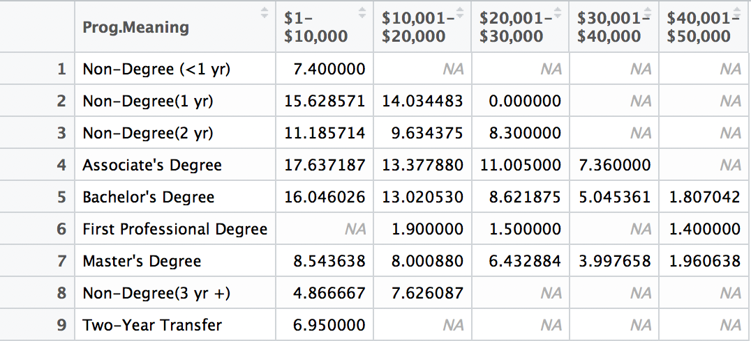
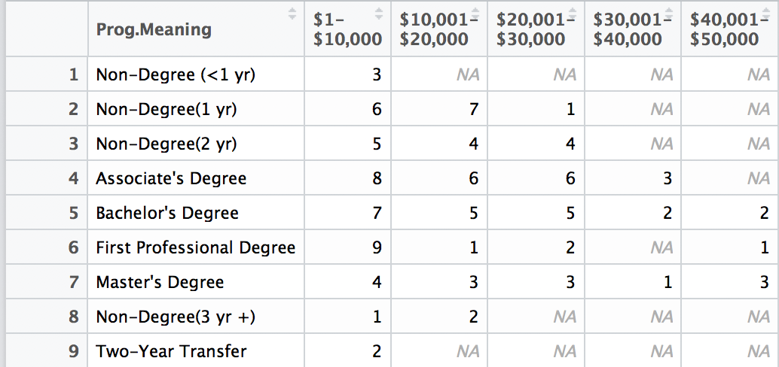
Default Rates (summary tables)
Notes:
Cody

Slide 10
Analysis 2 – r script
Notes:
Ben

Slide 11
Analysis 2 - graph
Notes:
Ben

Slide 12
Analysis 3 – R script Default loan rate by location
GOAL: Plot (using longitude and latitude) default rates by location for US, a given state and year
CONSIDERATIONS:
CohortDefault Rate - Range of default rates (0 – 39.3) skews results, removed results 0 – 5%
Year – Two years of data, reduce map to just one year of data
Longitude and Latitude – Retain only the contiguous 48 states data
State – Allow for ability to map just one state
Notes:
Kris

Slide 13
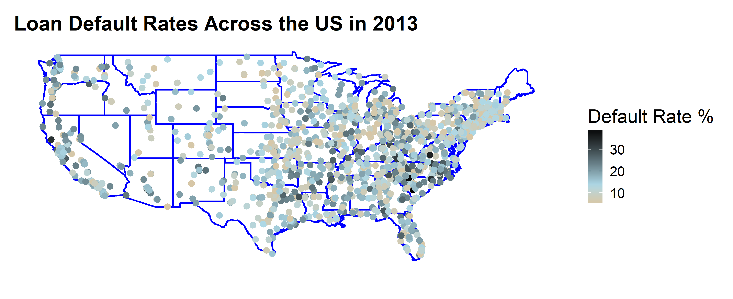
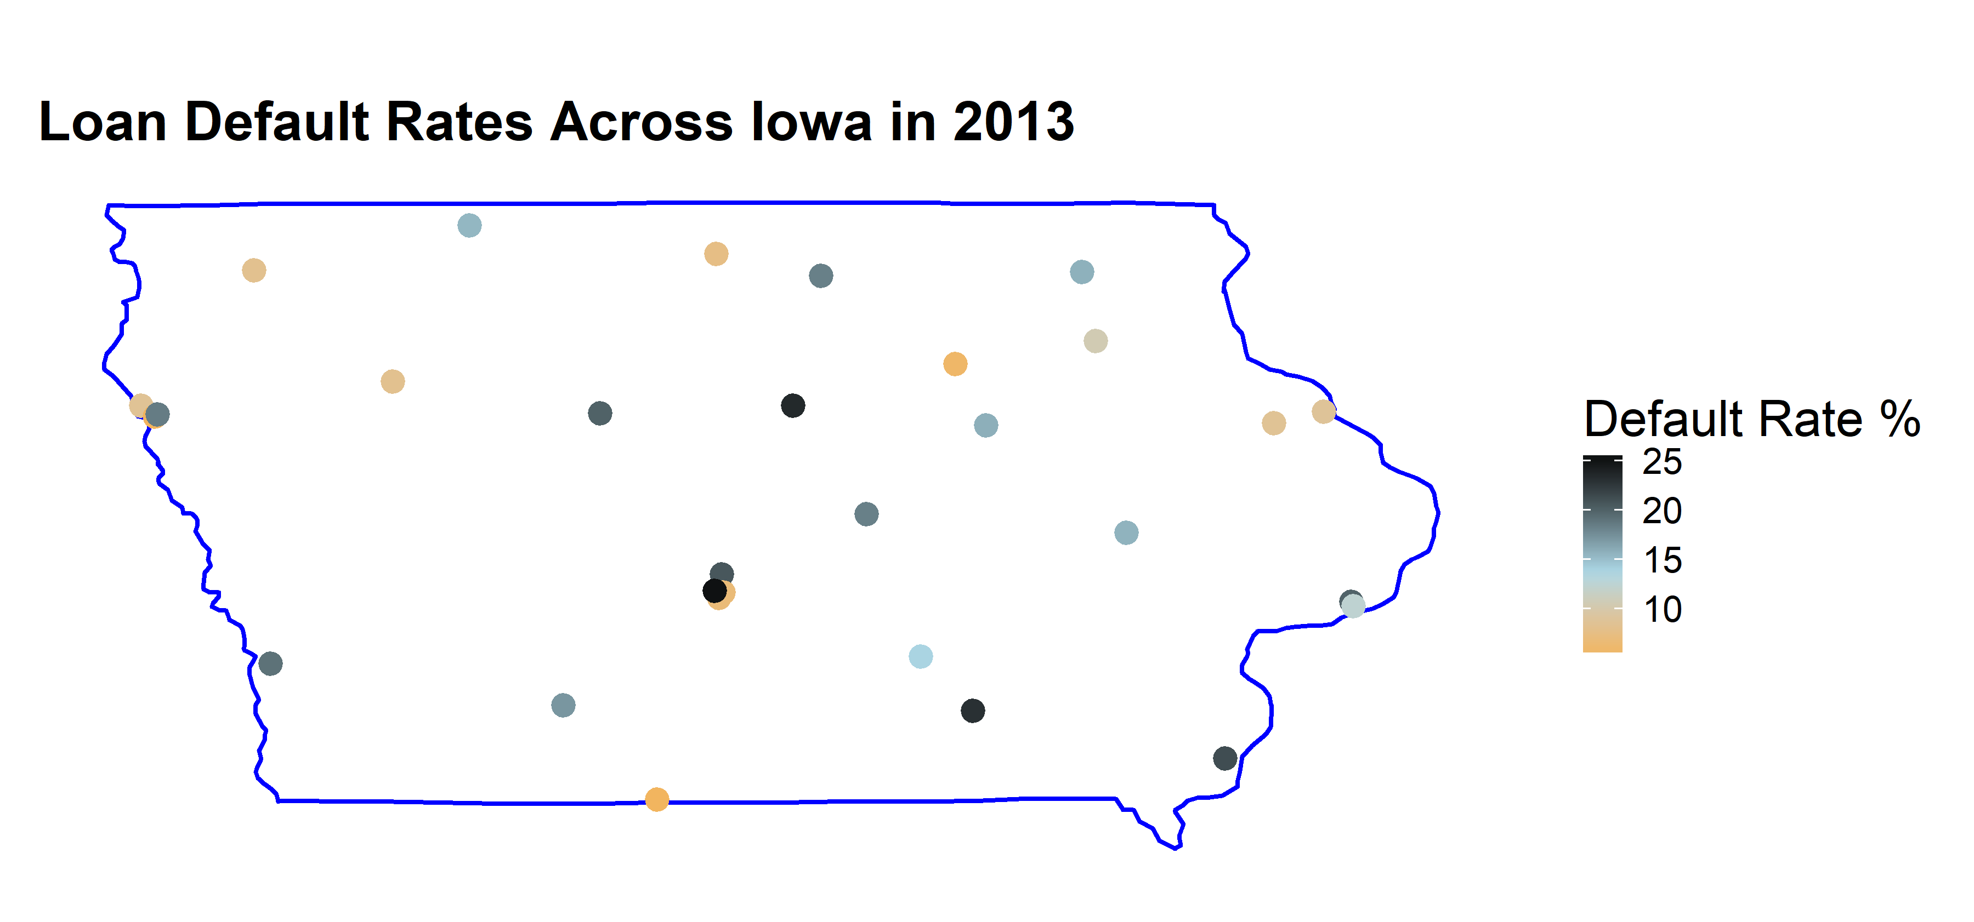
Analysis 3 – graph DEFAULT RATE BY LOCATION
Notes:
Kris

